Slide 1
Lecture # 03 layouts & views in android studio
Software Application & Mobile Devices

Slide 2
outcomes
After completing this lab student will be able to understand:
Understanding of RelativeLayout: Gain a solid understanding of how the RelativeLayout works and how to position views relative to each other using layout attributes.
Proficiency in View Placement: Develop proficiency in placing views within a RelativeLayout using attributes like android:layout_below, android:layout_toRightOf, and others.
UI Design Skills: Enhance UI design skills by creating a visually appealing and well-aligned student profile layout using appropriate spacing, alignment, and styling.
XML Layout Knowledge: Strengthen XML layout skills by effectively utilizing RelativeLayout and other relevant attributes to construct the desired student profile layout.
Responsive Design: Gain experience in creating a responsive layout that adapts to different screen sizes and orientations, ensuring the student profile layout remains visually pleasing and functional.
Problem-Solving: Improve problem-solving skills by overcoming any challenges or issues encountered during the implementation of the RelativeLayout and views for the student profile layout.

Slide 3



What are layouts in android studio
Layouts in Android Studio are used to define the structure and appearance of the user interface (UI) of an Android application. They serve as containers for arranging and organizing the various UI elements such as buttons, text fields, images, and more.

Slide 4


Why they are essential
Here are some reasons why layouts are essential in Android Studio:
Structuring UI: Layouts provide a way to organize and structure the UI elements in a logical manner. They allow you to group related elements together, define their positioning, and establish the overall hierarchy of the UI.
Responsive Design: Layouts enable you to create responsive UIs that adapt to different screen sizes and orientations. By using appropriate layout types and configuring their properties, you can ensure that your app's UI scales and adjusts correctly on various devices.
Reusability: Layouts promote code reuse by allowing you to define common UI components or templates that can be used across multiple screens or activities. This can help in maintaining a consistent look and feel throughout the application.
Adaptability: Android supports different device configurations and screen densities. Layouts provide the flexibility to handle these variations by allowing you to define different layouts for different device configurations. You can create separate layouts for phones and tablets or provide alternative layouts for landscape and portrait orientations.
Visual Design: Android Studio provides a visual editor for layouts, allowing you to design the UI visually by dragging and dropping UI elements onto the layout canvas. This visual approach simplifies the process of creating and editing layouts without having to manually write XML code.

Slide 5
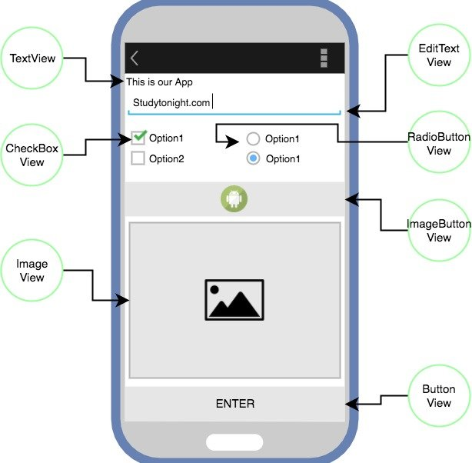
What are views in android studio
In Android Studio, views are the fundamental building blocks of the user interface (UI) in an Android application. Views represent the visual elements that users can see and interact with on the screen. They include buttons, text fields, images, checkboxes, progress bars, and many more.

Slide 6
Views are essential for:
View Hierarchy: Views are organized in a hierarchical structure known as the view hierarchy. The top-level view is typically the root view of the layout, and it contains child views nested within it. Views can be nested inside other views to create complex UI layouts.
View Types: Android Studio offers a wide range of predefined view types that cover various UI components. Each view type is designed for a specific purpose and has its own set of properties and methods. Examples of common view types include TextView, Button, EditText, ImageView, and Linear Layout.
View Properties: Views have properties that determine their characteristics, such as size, position, color, text content, and more. These properties can be set in the XML layout files or programmatically in the Java/Kotlin code. Android Studio provides autocomplete and code assistance for accessing and manipulating view properties.
Event Handling: Views can respond to user interactions through event handling. For example, you can attach click listeners to buttons to perform actions when the button is clicked. Android Studio simplifies event handling by generating event listener templates and providing shortcuts for common event-related operations.

Slide 7
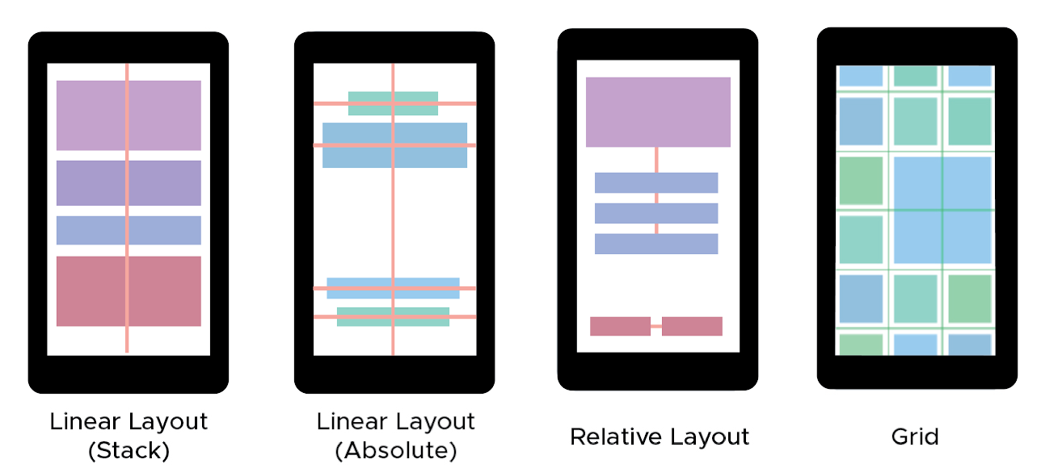
What is linear layout:
LinearLayout:
LinearLayout arranges child views in a linear fashion either horizontally or vertically.
It supports two orientations: horizontal (android:orientation="horizontal") and vertical (android:orientation="vertical").
Child views are added one after another in the specified orientation.
Each child view can take up a portion of the available space based on its layout_weight attribute.
LinearLayout is useful for simple UI structures where views are arranged in a linear manner.

Slide 8
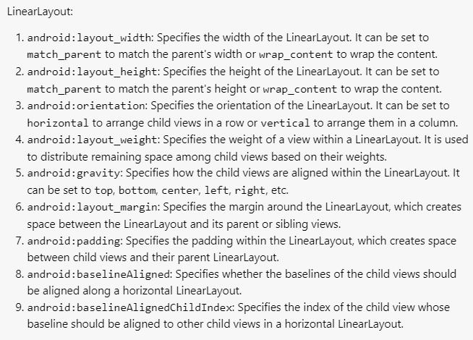
Important properties of linear layout

Slide 9
What is relative layout:
RelativeLayout:
RelativeLayout allows child views to be positioned relative to each other or relative to the parent.
Views are positioned using a set of rules defined in XML attributes such as android:layout_alignParentTop, android:layout_below, android:layout_toLeftOf, etc.
Views can be aligned to the parent edges, to other views, or relative to a specific view.
RelativeLayout offers more flexibility in positioning views compared to LinearLayout.
It is useful for building complex UI designs where views need to be positioned relative to each other or when the relationships between views are dynamic.

Slide 10
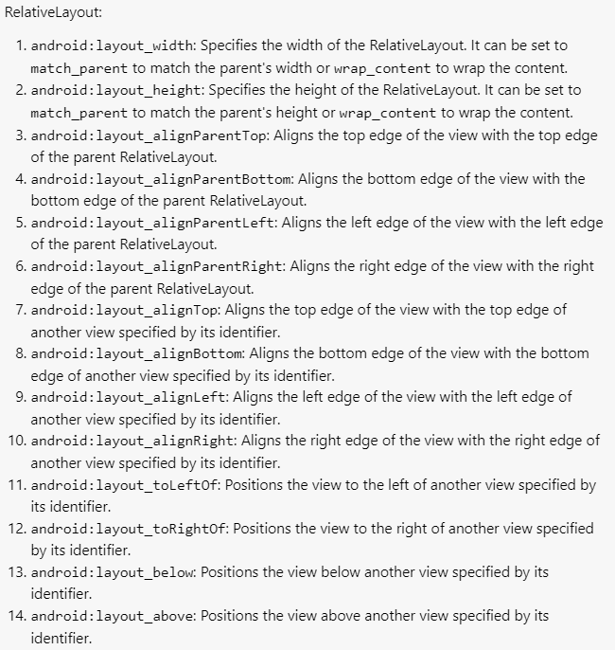
Important properties of relative layout

Slide 11
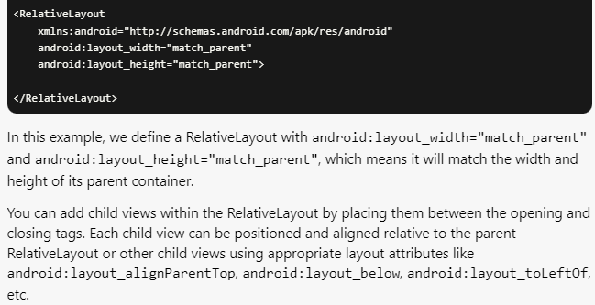
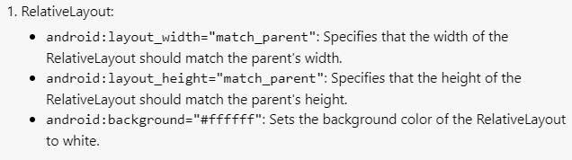
Relative layout

Slide 12
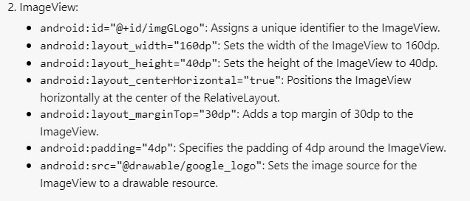
Image view
In Android, an ImageView is a UI element that is used to display images or drawables within an application. It provides a container for visual content in the form of images.

Slide 13
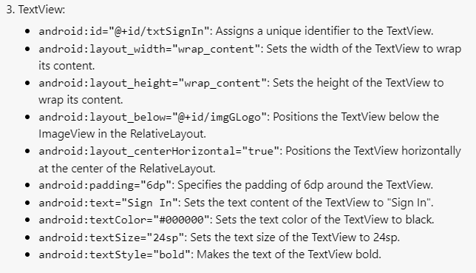
Text view
In Android, a TextView is a UI element that is used to display text content to the user. It is a non-editable component and
is commonly used for displaying labels, instructions, descriptions, or any other textual information in an application.

Slide 14
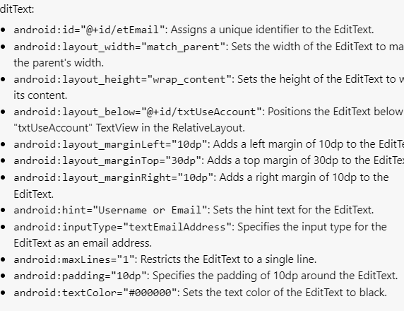
Edit text view
In Android, an EditText view is a UI element that allows users to input text. It provides a text field where users can enter and edit text data.

Slide 15
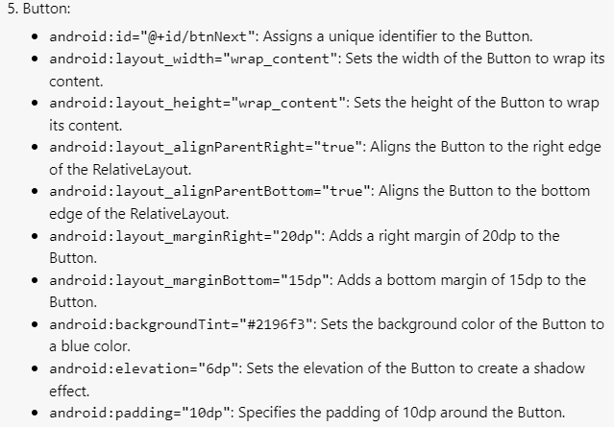
Button view
In Android, a Button view is a UI element that allows users to trigger an action or submit a form by tapping on it. It is a clickable widget that typically displays a label or an icon indicating its purpose.

Slide 16
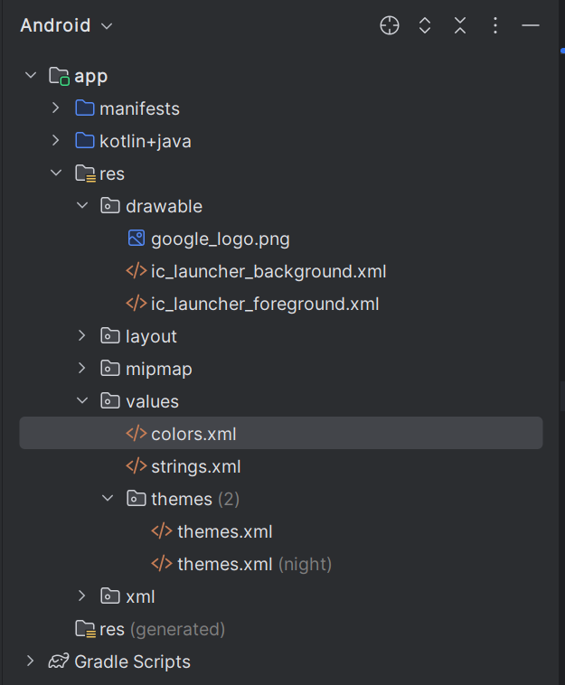
Example directory structure

Slide 17
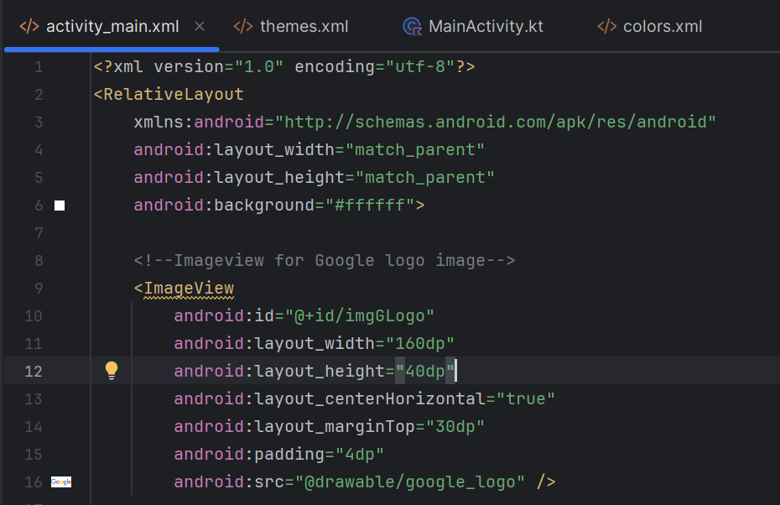
Code : activity main.xml

Slide 18
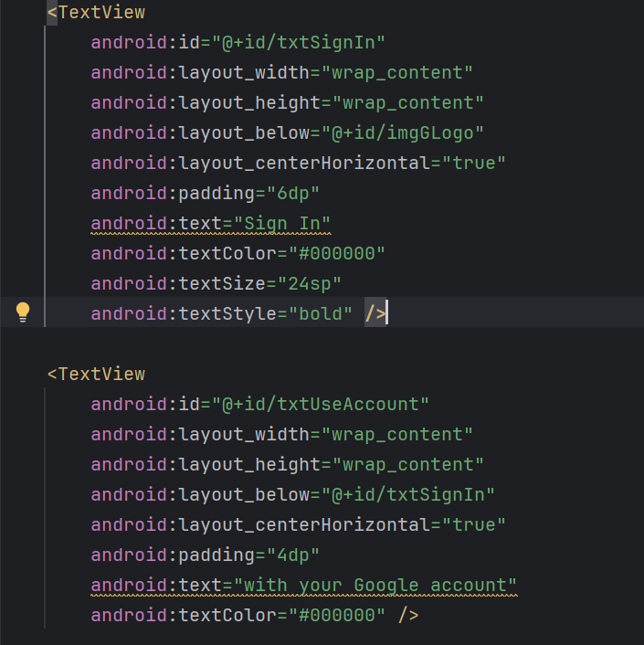
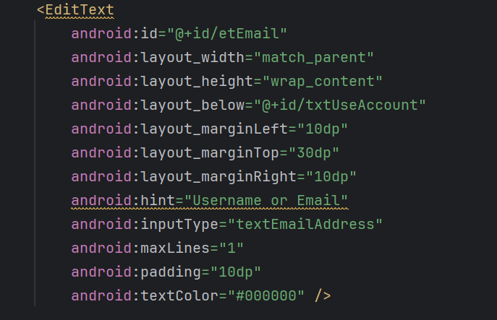
Activity main.xml

Slide 19
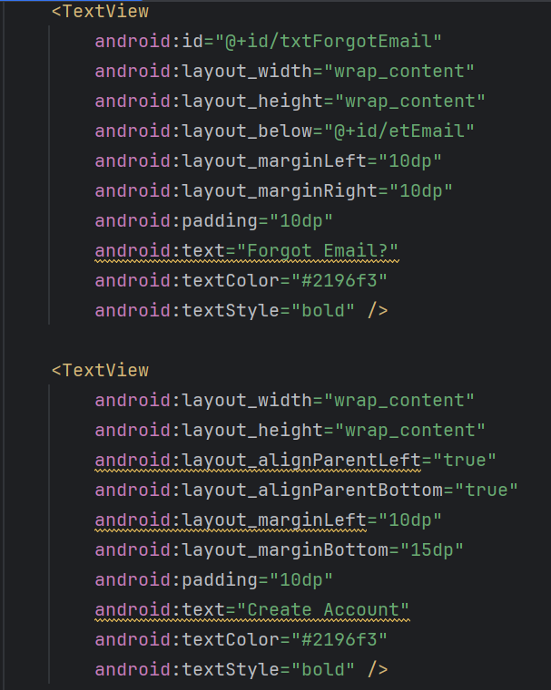
Activity main.xml

Slide 20
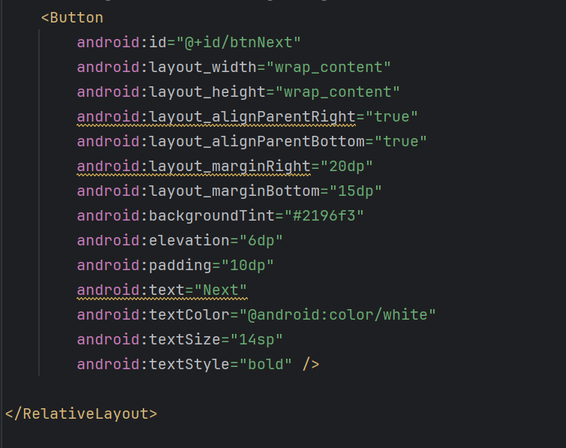

Activity main.xml

Slide 21
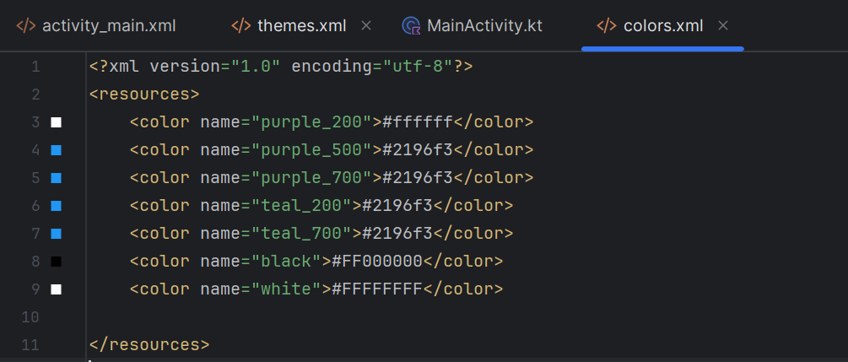
Colors.xml

Slide 22
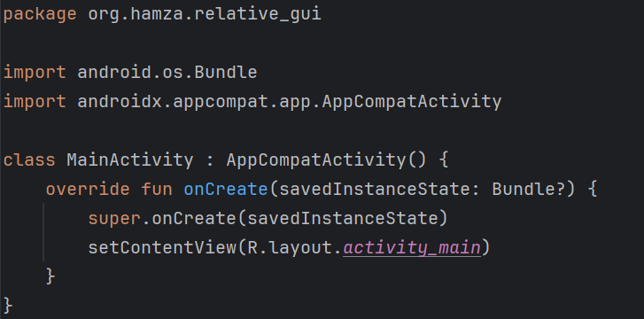
Mainactivity.kt (Kotlin example)

Slide 23
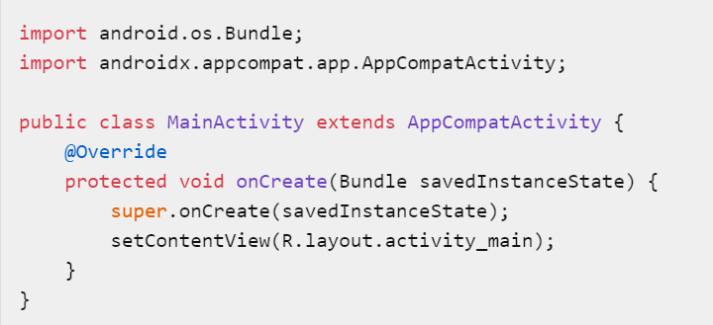
Mainactivity.java(java example)

Slide 24
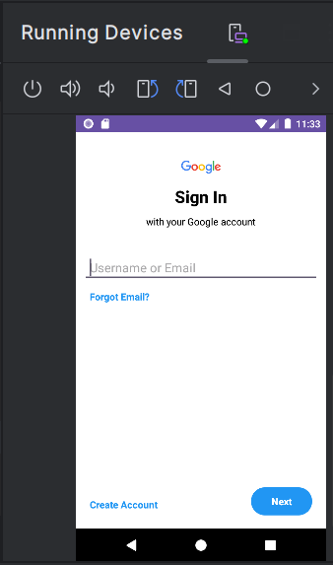
Output:

Slide 25
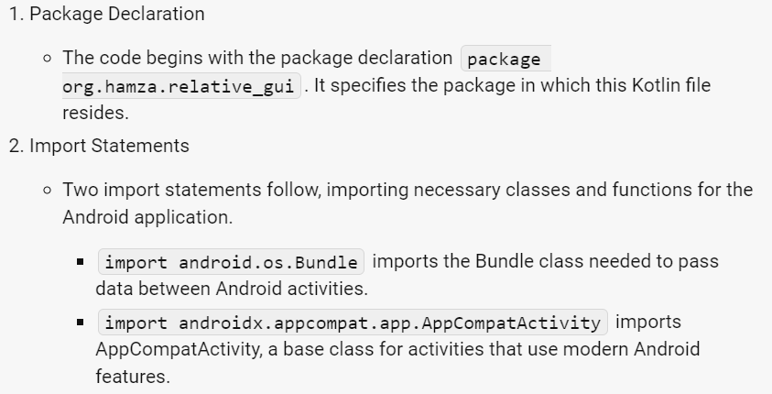
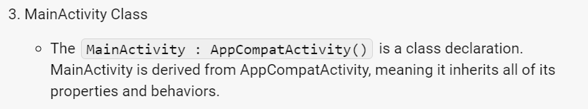
Explanation of main.kt

Slide 26
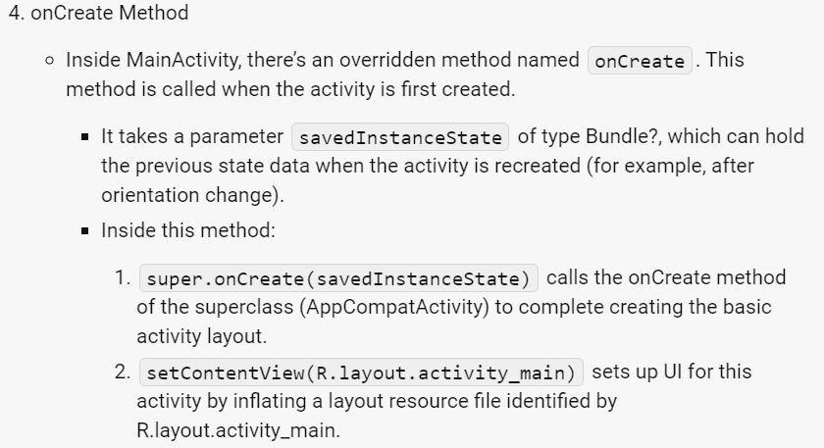
Explanation of main.kt

Slide 27
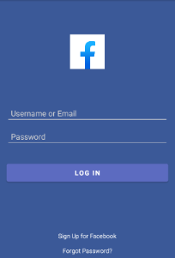
Task1:
Implement Facebook Login UI using Relative Layout

Slide 28
Task 2:
Student Profile Layout
Create a student profile layout using RelativeLayout. The layout should display the student's name, age, grade, and a profile picture.
Requirements:
Use a RelativeLayout as the parent layout.
Display the student's name centered horizontally at the top of the layout.
Display the student's age and grade below the name, aligned to the left side of the layout.
Place the profile picture to the right of the student's name, slightly below the name, with some margin between them.
Ensure that the layout is visually appealing and provides sufficient spacing and alignment.

